Slide 1
CW2: Traffic Analysis
using Wireshark
Group 21 Class UC-204

Slide 2

Contents
System security
a
a)The Transmission Control Protocol (TCP) and User Datagram Protocol (UDP), and the difference between the two protocols
c
The Difference between TCP and IP
b
d
b)The Internet Protocol (IP)
The work of the TCP 3-Way Handshake Process.
speaker:Hongbo Li

Slide 3
Contents
System security
a
The Transmission Control Protocol (TCP) and User Datagram Protocol (UDP), and the difference between the two protocols

Slide 4

a) The Transmission Control Protoca) The Transmission Control Pr、
TCP is a connection-oriented protocol that provides reliable, ordered, error-checked data transfers between applications. UDP is a connectionless protocol that provides no guarantees around the delivery, order, or avoidance of duplication of data. TCP is designed to optimize reliability at the expense of speed, whereas UDP is designed to optimize speed at the expense of reliability.
Schematic diagram of the difference between TCP and UPD
function | TCP | UDP
Whether there is a link | connection-oriented | Non-link oriented
Transmission reliability | reliable | unreliable
speed | slow | fast
Application scenario | Large amount of data is transmitted | The amount of data transmitted is small

Slide 5
Contents System security
b
The Internet Protocol (IP)

Slide 6
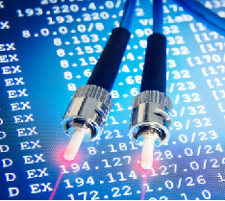
The amount of data transmitted is small
Internet Protocol (IP) is one of the core protocols of the TCP/IP suite and is used to manage the routing and delivery of data packets over the Internet. IP addresses and fragments data packets and provides the basic mechanism for routing data packets between devices.
IP is a connectionless protocol, which means that it does not create a virtual circuit between the sender and the receiver before transmitting data.
An IP address is a unique identifier assigned to each device on the Internet and used by the routing function to guide packets to their destination.

Slide 7
Contents System security
c
The Difference between TCP and IP

Slide 8
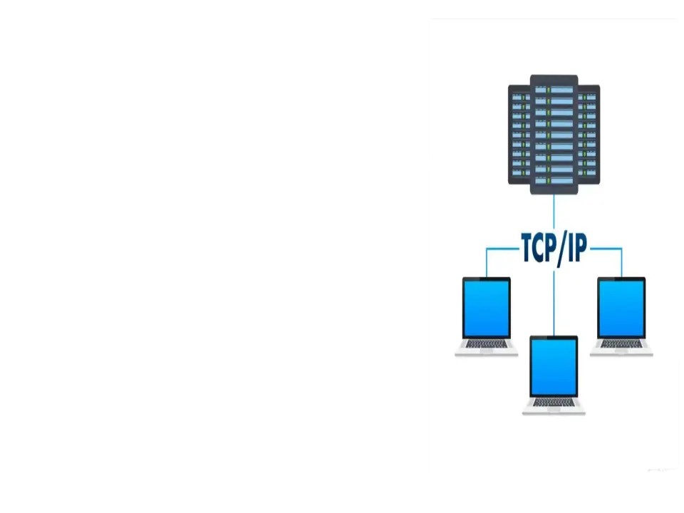
IP is responsible for routing packets across the network from one device to another. It identifies the source and destination of each packet and ensures that the packet reaches its intended destination.
TCP, on the other hand, is a transport-layer protocol that provides reliable, ordered data transfer services between applications running on different devices.
In short, IP provides the basic mechanism for transferring data over a network, while TCP provides the reliability and sequence of data transfers between two end-to-end devices.

Slide 9
Contents System security
d
The work of the TCP 3-Way Handshake Process.

Slide 10

The three steps for TCP 3-Way Handshake are:
SYN (synchronization) : This process is initiated by the sending device, sends a SYN packet to the receiving device, indicating that it wants to establish a connection, and asks the receiving device to reply with a SYN-ACK (acknowledgement of synchronization).
Syn-ack: The receiving device responds to a SYN packet by sending a SYN-ACK packet to the sending device. This packet acknowledges receipt of the SYN packet and indicates that it is ready to establish a connection.
ACK: The sending device sends an ACK packet to the receiving device to confirm that it has received the SYN-ACK packet and that the connection has been established.

Slide 11
2
Describe and contrast the Denial-of-Service (DoS) and Distributed Denial-of-Service (DDoS) attacks, and their sub-types.
Speaker: siqi Li

Slide 12



Principle introduction
System security
introduction
Denial of service (DoS) and distributed Denial of Service (DDoS) attacks are both types of cyber attacks that aim to render a website or network unusable by overwhelming it with traffic. However, there are some key differences between the two.

Slide 13



Dos Attack
System security
Hacker
A DoS attack is a cyber attack designed to disrupt the availability of a website or network by flooding it with traffic. An attacker uses a single device, or multiple devices controlled by a single.
person, to deliver large amounts of traffic to the target system. This prevents users from using the target system, which can lead to significant financial loss or reputational damage.
Q
F

Slide 14
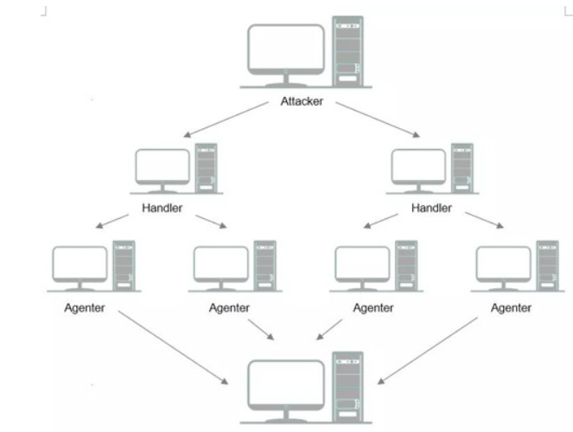
System security
DDos attack
Similar to DoS attacks, DDoS attacks
aim to make a website or network unavailable.
However, DDoS attacks are more sophisticated
and widespread.
They use multiple devices, such as botnets, to
launch coordinated attacks on targeted systems.
A botnet is a collection of compromised devices
controlled remotely by an attacker.

Slide 15
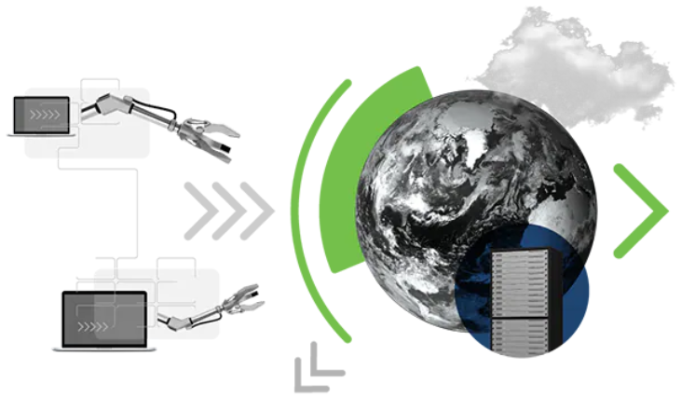
System security
Here are some subtypes of DoS attacks:
ICMP flood attack;
SYN flood attacks;
UDP flood attack;
Smurf attack;
It is worth noting that network attacks caused by a single ip address cannot be regarded as ddos attacks. Attacks caused by a single ip address can only be dos attacks.

Slide 16
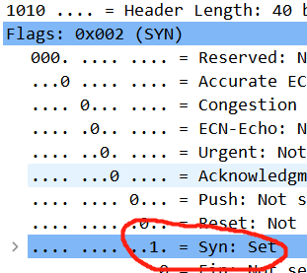
syn attacks are involved in this attack
attack
principle
The IP address of this analysis is 192.168.1.64,
and the syn attack mode is used.
Syn-ddos attack:
The attacker sends legitimate SYN requests to multiple servers, but does not accept SYN-ACK replies from the server until the server times out.
When a server receives a large number of SYN requests in a short period of time, performance degrades or crashes due to wait timeouts.

Slide 17
TOPIC
System security
3
In the provided PCAP file, identify the type of the attack
SPEAKER：Liao Zeping

Slide 18
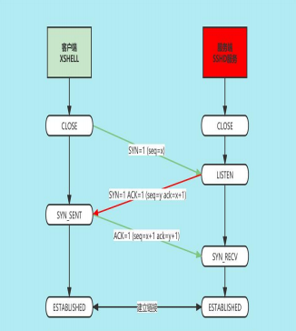
Precondition
System security
To establish a connection between a client and a server, a three-way handshake is performed.
Therefore, if the server does not respond to a large number of requests, check whether the server is attacked and then check the ip address of the client.

Slide 19
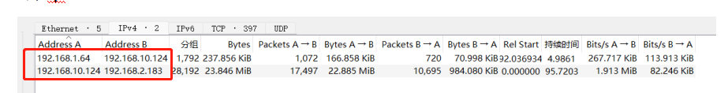
Conclusion
System security
As shown in the figure, we can see that a client IP is 192.168.1.64
And another client IP is 192.168.2.183.
Server side IP is 192.168.10.124.
So, when checking if we are under attack, we have to pay extra attention to these two clients, how do we check them?
Check whether the server responds to the synchronization request.

Slide 20
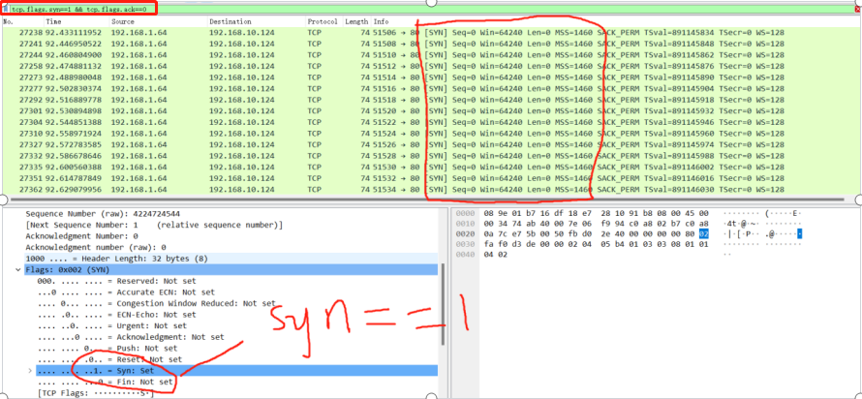
Conclusion
System security
This way, we can easily filter it out with tcp.flags.syn==1 && tcp.flags.ack==0 to check for DOS attacks, as shown below
Almost the same request, this is not intuitive enough so we need to look at the i/o graph next

Slide 21
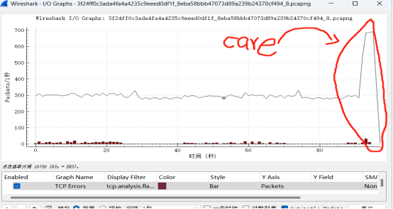
Conclusion
System security
I/O Graph
This is obvious, about 92 seconds before the syn packet fluctuates around 300, after 92 seconds, the syn request is extremely increased

Slide 22
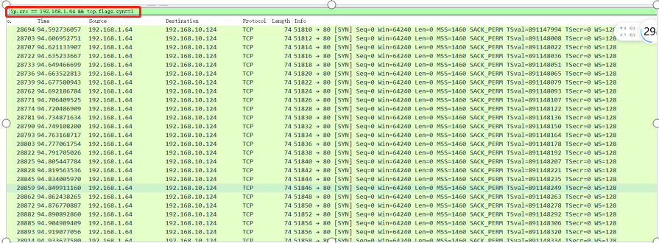
Conclusion
System security
We then use the filter condition ip.src == 192.168.1.64 && tcp.flags.syn==1 to filter the data again
This will show that it is a dos attack, and the large number of syn requests may cause the server to crash. Let's turn on the filter restrictions and check the session.

Slide 23
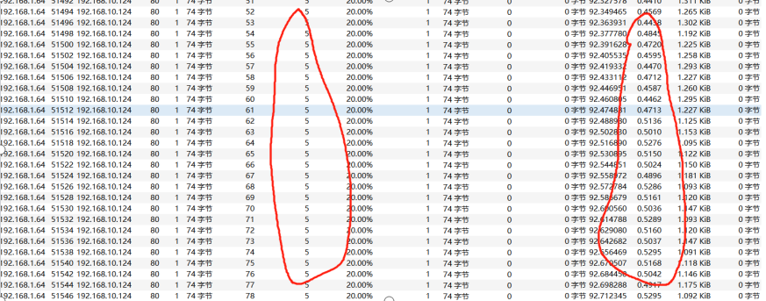
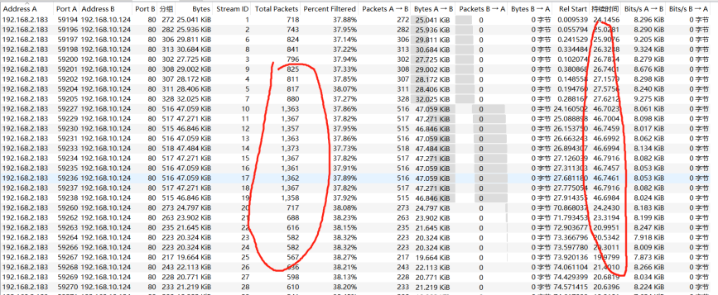
Conclusion
System security
Each send five packets, and a very short interval, it is clear that the server is under attack.
Not finished, there is a suspicion 192.168.2.183.
We open the filter and enter
ip.src == 192.168.2.183, check the session
Send a large number of packages

Slide 24
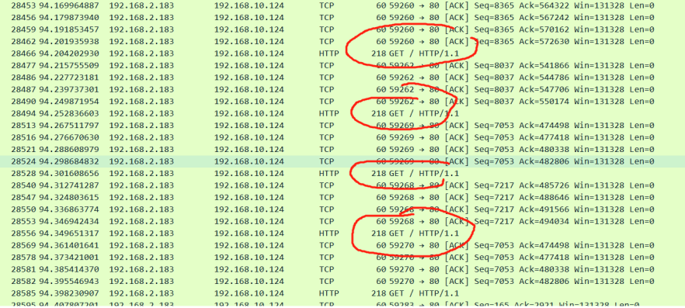
Conclusion
System security
All are IP 192.168.2.183HTTP/Get requests, basically belong to DDOS attack

Slide 25
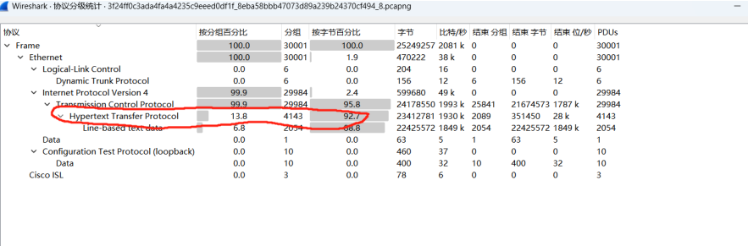
Conclusion
System security
Only a single ip initiated attacks can not be seen as ddos attacks.
Ninety percent or more are http request responses.
But this attack involves two ip addresses. And the scale of the attack is very large.
Judging from this, a large number of repeated requests for the same content, basically judged to belong to the ddos attack

Slide 26
目录
Networking
4
What is the IP address of the suspected attacker in PCAP file?

Slide 27
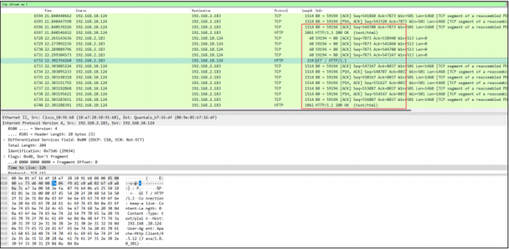
Problem analysis
System security
Suspected attacker IP: 192.168.2.183, frequent request repeated web content, should be httflood type ddos attack

Slide 28
Precondition
System security
What is httpflood type ddos attack
HTTP Flood is a attack on Web services on the seventh layer protocol (application layer). Its huge harm is mainly manifested in three aspects: convenient, difficult filtering, and far -reaching influence. The HTTP FLOOD attack searches anonymous HTTP agent or SOCKS agent on the Internet through port scanning program. The attacker initiates the HTTP request to the attack target through anonymous agents. Anonymous agent is a relatively abundant resource. It is not difficult to get an agent for a few days. Therefore, attacks are easy to initiate and can continue for a long time. The HTTP FLOOD attack was launched on the HTTP layer, and the web page request behavior of normal users was vigorously imitated. It was closely related to the website business. It is difficult for security manufacturers to provide a general -purpose solution without affecting the user experience. HTTP FLOOD attacks can cause serious chain reactions, not only the slow -attacked Web front -end response, but also indirectly attacking the back -end Java and other business layer logic and more back -end database services, increasing their pressure, and even the logs of the logs. The storage server has an impact.

Slide 29
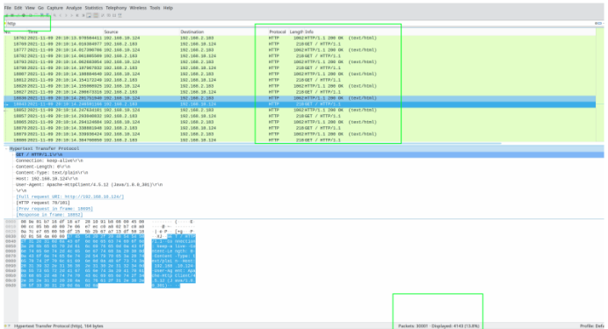
Conclusion
System security
It can be seen that 192.168.2.183 repeatedly request the same ip 192.168.10.124 and different port request IP addresses, it is very likely that a large number of http requests, occupying the server resources, so that the server has no resources to provide other normal http request services. So this is a typical ddos attack of the http flood.

Slide 30
Contents
System security
5
Conclusion and Reflection
Speechmaker : Peter(yuwei Cui)
202015030405

Slide 31

Conclusion
System security
Conclusion
From the previous analysis, this attack is ddos, and the causes of ddos attack are syn flood and http get frequent repeated requests

Slide 32
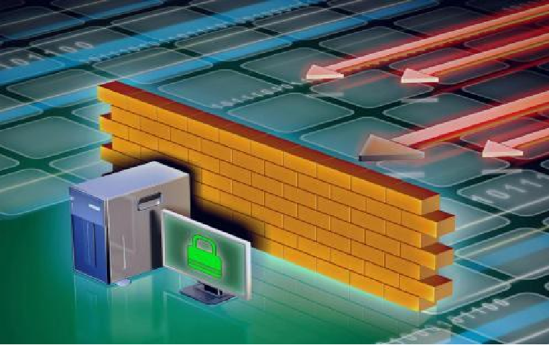
SYN flood Attack
System security
Causes
However, in a SYN Flood attack, the server that receives the SYN packet remains open while waiting for an ACK acknowledgement from the client and uses server resources to wait for a long time, resulting in wasted server resources and reduced server performance.
In a SYN Flood attack, the attacker sends a false TCP SYN packet, causing the server to send a SYN-ACK response to the attacker, and then waits for the client to send an ACK acknowledgement to complete three handshakes.

Slide 33

SYN flood Attack
System security
Precautionary measures
Most importantly, implement best network programming principles and develop secure, defensive programming designs to minimize the impact of malicious network behavior on network security.
Measures to protect against SYN Flood attacks include the use of firewalls, IPS or other network security devices to detect and block attack traffic.

Slide 34
Http get frequent repeat requests
System security
Causes
Network connection problems
Client application issues
Proxy server issues
Web Server Resources
The proxy server may cache requests as they are delivered
Client applications may send HTTP GET requests on every page load
Web server resources may lead to frequent duplication of HTTP GET requests
HTTP GET requests may be affected by network problems。

Slide 35

Reflection
System security
Solution
To reduce the frequent repetition of HTTP GET requests, you can reduce the requests and burden on the server by using cache control, or by using a more efficient protocol

Slide 36
references
Wireshark Official Site: https://www.wireshark.org/
Wireshark 101: Essential Skills for Network Analysis (2nd Edition) by Laura Chappell, 2013.
Troubleshooting with Wireshark: Locate the Source of Performance Problems by Laura Chappell, 2014.
Wireshark Network Analysis: The Official Wireshark Certified Network Analyst Study Guide (2nd Edition) by Laura Chappell and Gerald Combs, 2013.

